Slide 1
Practical Hierarchical Bayesian Modeling
Megan Shabram
September 21, 2017

Slide 2
What is your Science Question? Things to Keep in mind
Iterative approach
Awareness of probability distributions and When they are applicable.
What has nature told you about the physical process you want to investigate?
What evidence are you looking for?
Pick a model that performs well if nature is more complex (concerns model misspecification)
E.g., using Beta instead of Normal for the eccentricity distribution

Slide 3
One- Two and Three- component Gaussian Mixture Model
Exchangeability
Separable distributions

Slide 4
Model Complexity vs. Size of Dataset
Statistical significant vs. prediction. Variables that are statistically significant may be bad predictors and vice versa.
Under- and over- fitting are issues for predictions.
Solution: Find a model that is relatively insensitive to the generative model.
Models may converge in less iterations for larger datasets with precise measurements

Slide 5
Measurement Uncertainty
Is it normally distributed?
Do you have the full posterior or a summary statistic?

Slide 6
Advancements in Exoplanet Science
Kepler Mission:
~ 5000 exoplanet candidates discovered
~ 3000 Eclipsing Binaries
Brightness
Time

Slide 7
Converging on Planet Formation from Multiple Paradigms
Connecting Short-period Tightly-packed Inner Planetary Systems (STIPS) formation to gas-giant planet formation.
Detection of “hot-Jupiters” demanded generalizing planet formation theories.
“Sub-Neptunes” are dominant result of planet formation. Theories must be expanded further.
Notes:
Explaining the formation of Solar System
Detection of “hot-Jupiters” questions generalized planet formation theories.
“Sub-Neptunes” are dominant result of planet formation. Theories must be expanded further.
Connecting Short-period Tightly-packed Inner Planetary Systems (STIPS) formation to gas-giant planet formation.

Slide 8
What can we learn from population studies of exoplanets?
More than one population in the eccentricity distribution would support more than one mode of planet formation, e.g.,
planet-planet scattering
tidal circularization
smooth disk migration
Resonant repulsion
Planet-planetesimal disk interactions (Chatterjee & Ford 2014)
Correlations of eccentricity may expose a “tunable” generalized planet formation theory, e.g.,
host star metallicity
host star effective temperature
planet radius
orbital period
(Shabram et al. 2015, accepted to ApJ)

Slide 9
What can we learn from population studies?
The mass-radius relation probes whether planets:
formed in situ and may be is composed mostly of iron and silicates with a hydrogen-helium abundant atmosphere.
formed beyond the snow line and migrated closer to host star.
has undergone episodes of mass gain and/or mass loss.
Complicated since multiple compositional regimes can be consistent with a given mass and radius of an exoplanet.
(Rogers & Seager, 2010; Valencia et al., 2013; Lopez & Fortney, 2014)

Slide 10
Limitations of Studying the Kepler Exoplanet Population
Geometrical bias, selection effects
Planet detection efficiency (completeness)
Measurement uncertainty for planet and host star properties
Is sample representative?
Potential false positives among planet candidates

Slide 11
Challenges for Robust population Inference
Include measurement uncertainties (in population studies).
Include non-detections to minimize sampling bias (e.g., case study 2, the mass-radius-eccentricity relationship).
Include posterior distributions in population studies.
Incorporate false positive rate and detection efficiency.

Slide 12
Hierarchical Bayesian Modeling Addresses these Challenges
Incorporate uncertainty unique to each observation into the inference population parameters.
Address impact of selection effects and sample bias.
Use information about all objects to improve inferences about each object (“pool and muster strength”).
Test sensitivity to model misspecification.

Slide 13
Case Study 1: The Eccentricity Distribution of Short-Period Kepler Planet-Candidates and Eclipsing Binaries
How common are short-period giant planets with eccentric orbits vs. circular orbits?
Smooth disk migration
High-eccentricity migration
Planet-planet scattering
Kozai interactions
Secular processes followed by tidal circularization
How about for Eclipsing Binaries?

Slide 14
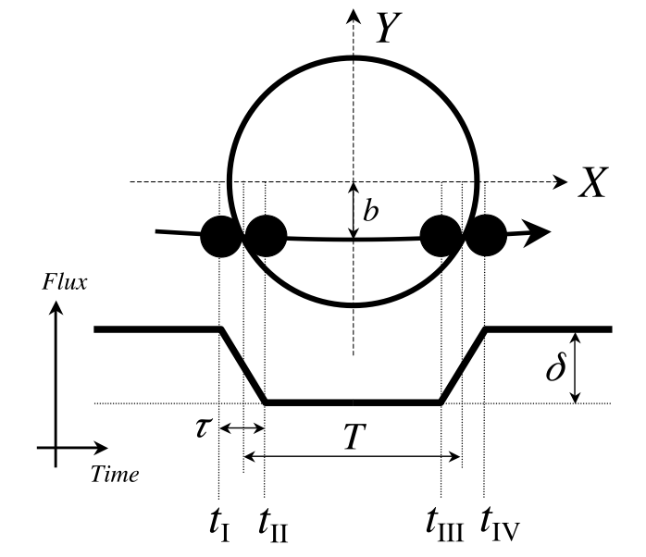
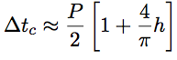
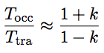
Case Study 1: The Eccentricity Distribution of Short-Period Kepler-Planet-Candidates and Eclipsing Binaries
Observables:
Phase offset (a) and transit duration ratio (b) relate transit observables to “projected eccentricity,” h and k.
Figure from Winn 2010
(a)
(b)
P = orbital period
h = e cos ω
k = e sin ω

Slide 15
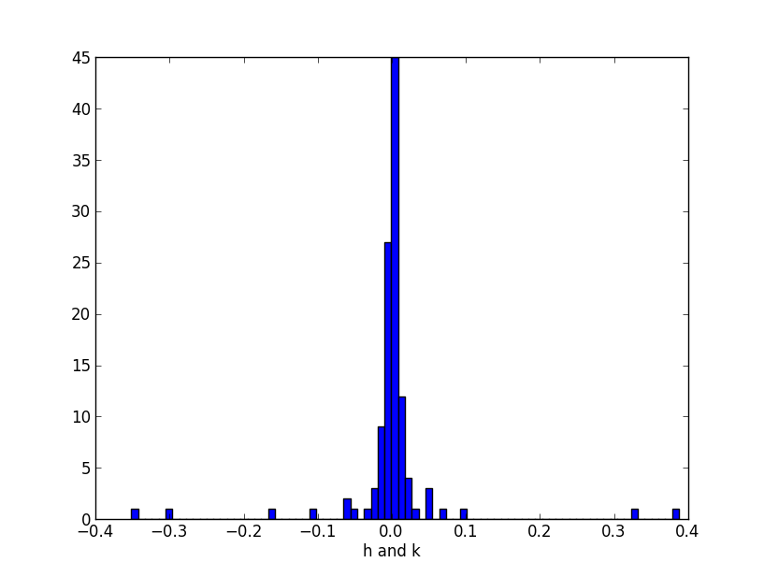
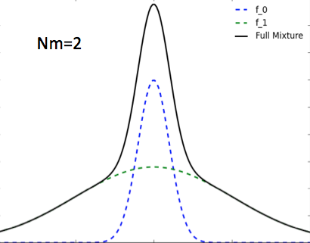
Input: Projected Eccentricity Measurements of Short-Period Kepler-Planet-Candidates
Ndata = 50
Frequency

Slide 16
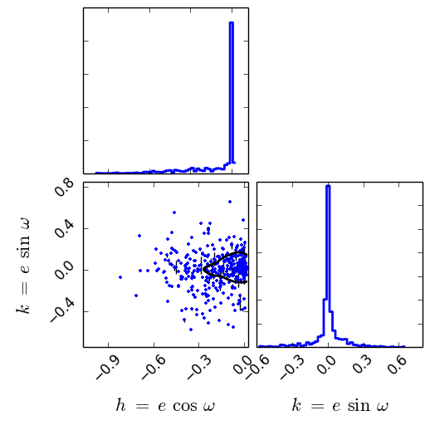
Input: Projected Eccentricity Measurements of Eclipsing Binaries from Kepler
Ndata=795
Frequency
Notes:
H may be bias but this is symmetric so results wouldn't change.

Slide 17
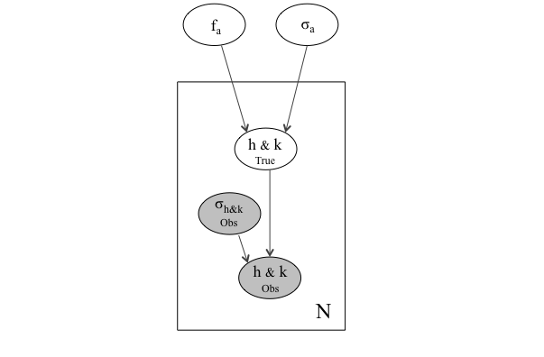
Case Study: The Eccentricity Distribution of Short-Period Kepler-Planet-Candidates and Eclipsing Binaries: Graphical Model
Population parameters (e.g., hyperparameters)
Latent variables
f_{a} => vector of mixture fractions
σ_{a} => vector of dispersions
h&k_{true} => true projected eccentricities
h&k_{obs} => measurements
σ_{h&k} => measurement uncertainties
Measurements and measurement uncertainties

Slide 18
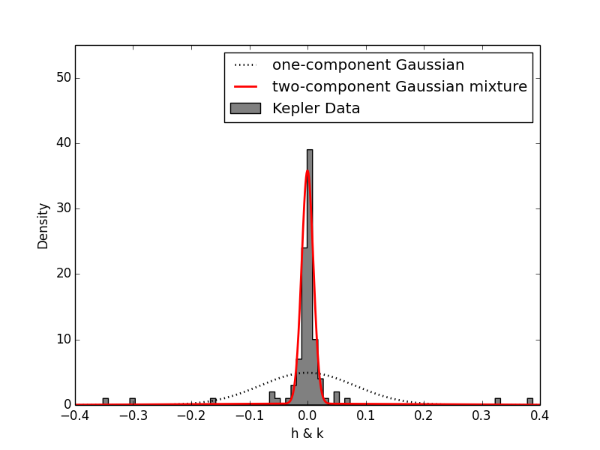
Case Study 1: Short-Period Kepler-Planet-Candidates show evidence of at least two populations in the eccentricity distribution:
f_{low} ~ 10%
σ_{low} ~ 0.01
f_{high} ~ 90%
σ_{high} ~ 0.22
σ = 0.8
Shabram et al. 2016

Slide 19
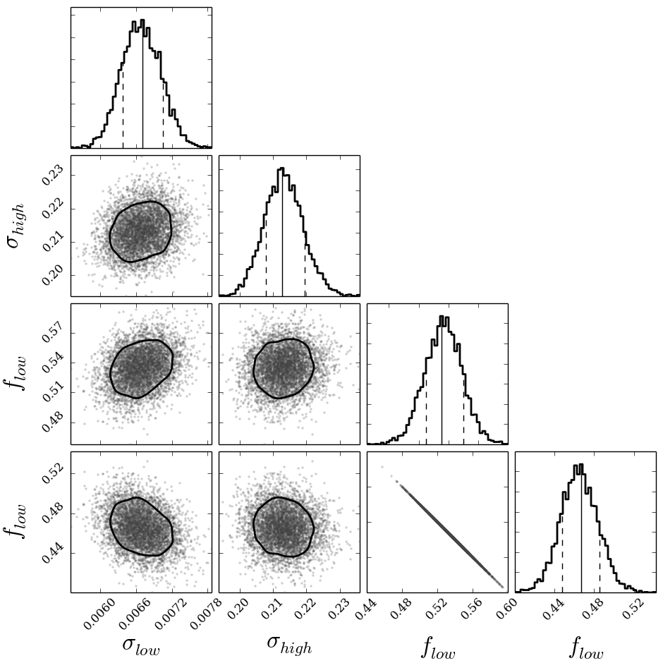
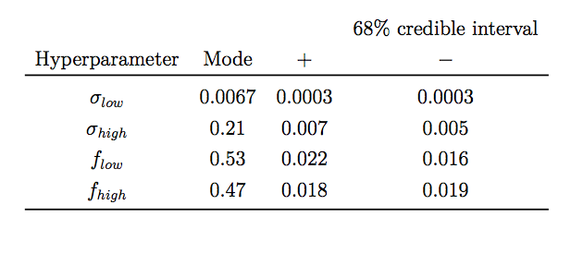
Case Study 1: Eclipsing Binaries from Kepler show evidence of at least two populations in the eccentricity distribution:
Frequency
Precise measurements results in precise constraints on small eccentricity component
Shabram, Prsa et al. in prep

Slide 20
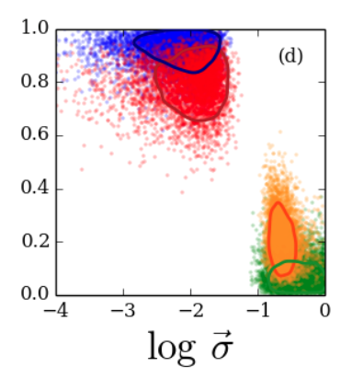

Case Study 1: Short-Period Kepler-Planet-Candidates: Potential correlation of eccentricity with stellar metallicity and planet radius
Stellar T_{eff}
Planet Radius
Blue and green represent posterior with stellar metallicity less than median
Red and orange represent posterior with stellar metallicity greater than median
Bottom half of sample (blue and green) consistent with zero and one
Orbital Period
Stellar Metallicity
stellar
metallicity
Shabram et al. 2015 accepted to ApJ
Notes:
Its both consistent with one and two component models.

Slide 21
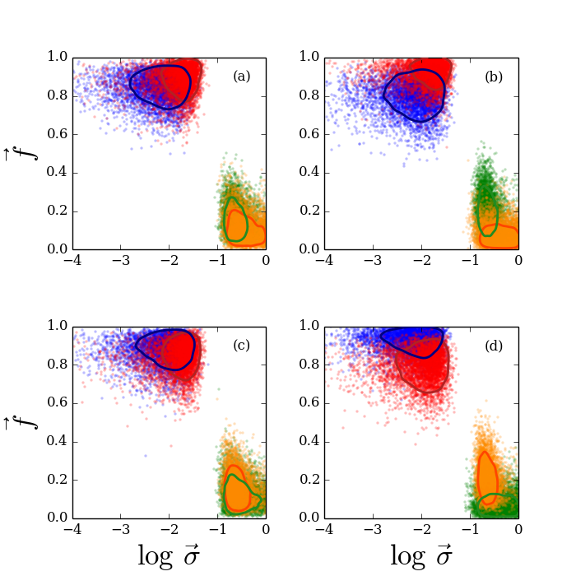
Case Study 1: Short-Period Kepler-Planet-Candidates: Potential correlation of eccentricity with stellar metallicity and planet radius
Stellar T_{eff}
Planet Radius
Blue and green represent posterior with stellar metallicity less than median
Red and orange represent posterior with stellar metallicity greater than median
Orbital Period
Stellar Metallicity
Similar effect for planet radius where large planet radii may be better characterized by a one-component model
Shabram et al. 2015 accepted to ApJ

Slide 22
Case Study: The Eccentricity Distribution of Short-Period Kepler-Planet-Candidates and Eclipsing Binaries: Potential Biases
Detection probability for occultation of planet-candidates.
Sample dominated by objects at shorter orbital periods
Potentially some diluted EBs present in the data set.
Planet-candidate sample enriched with smaller-radii host stars, higher effective temperature (Teff) host stars, larger planet radii/Teff.

Slide 23
Case Study 2: The Mass-Radius-Eccentricity Distribution of Near-Resonant Transiting Exoplanet Pairs
Empirically characterize the mass-radius relation
Learn about the eccentricity of transiting exoplanet pairs near first order mean motion resonance
Infer parameter estimates for masses and eccentricities using an analytical model that relates transit timing variation (TTV) amplitude to the the mass and eccentricity
Allow for a scatter in the planet mass at a given radius.

Slide 24
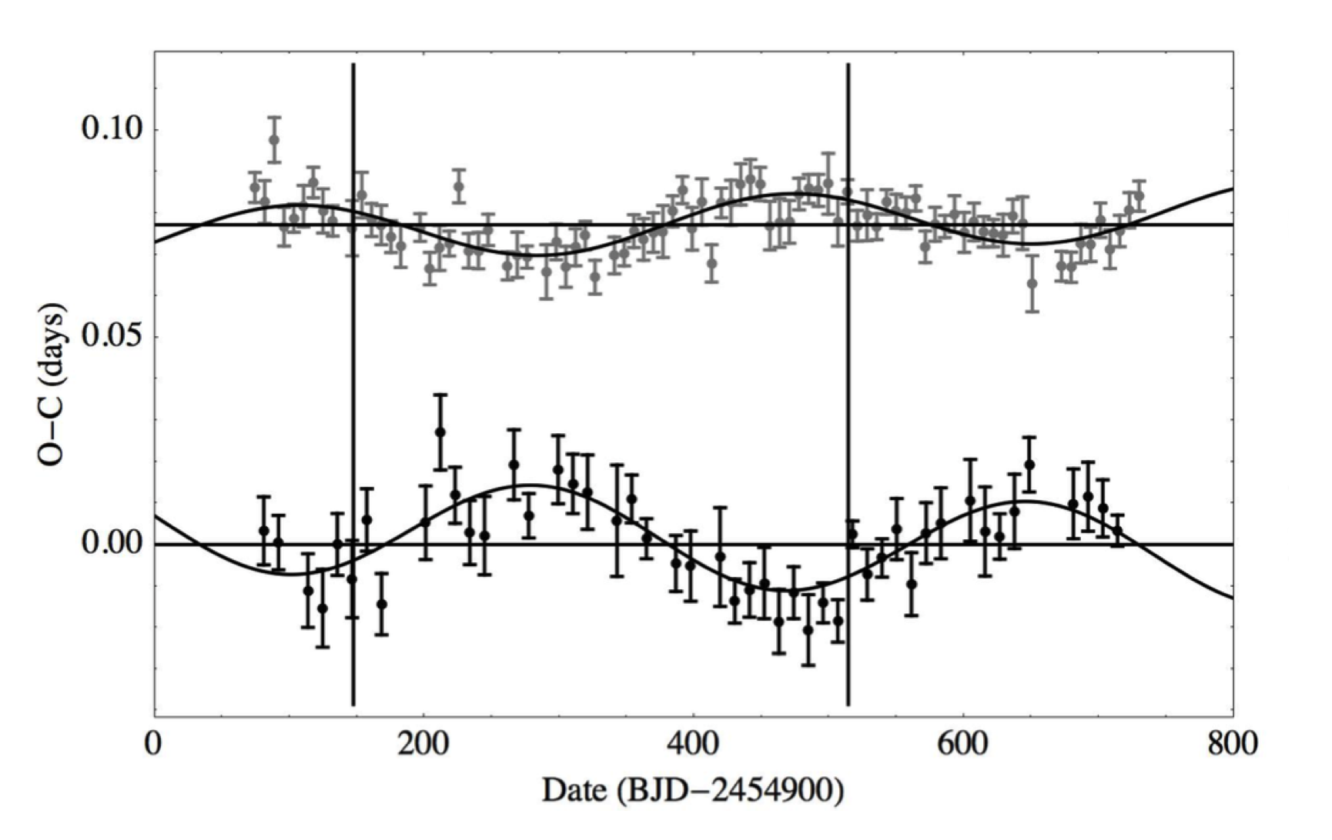


Case Study 2: The Mass-Radius-Eccentricity Distribution of Near-Resonant Transiting Exoplanet Pairs - Observables
Analytical relation for the transit timing
variation amplitude (Lithwick & Wu 2013):
Interior planet
Exterior planet
Figure from Steffen et. al. 2012
Transit timing variations for planet pairs near a first order resonance are well approximated by a sinusoid.
Near degeneracy between the mass ratio and eccentricity terms makes it difficult to constrain the mass for cases with non-zero eccentricity.

Slide 25
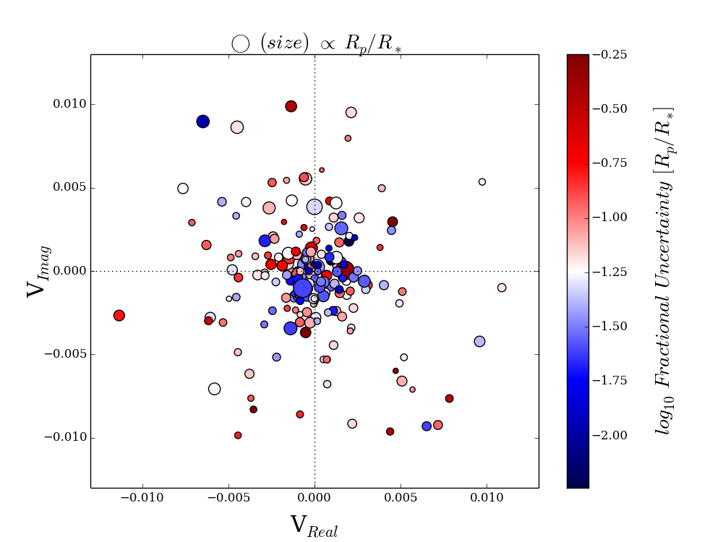
Input: The Mass-Radius-Eccentricity Distribution of Near-Resonant Transiting Exoplanet Pairs – Kepler data
Ndata = 120 planet pairs
Small fractional uncertainties improve chance of constraining HB model
TTV Amplitude (sin)
TTV Amplitude (cos)
\
Shabram, Jontoff-Hutter, Ford in prep

Slide 26
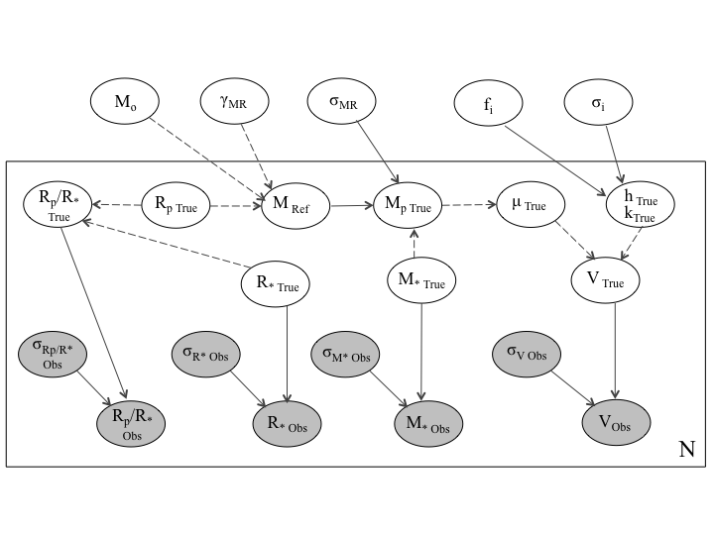
Case Study 2: The Mass-Radius-Eccentricity Distribution of Near-Resonant Transiting Exoplanet Pairs Graphical Model of Bayesian Network:
Population level parameters
(e.g., hyperparameters)
Latent
variables
Gray = measurements and measurement uncertainties

Slide 27
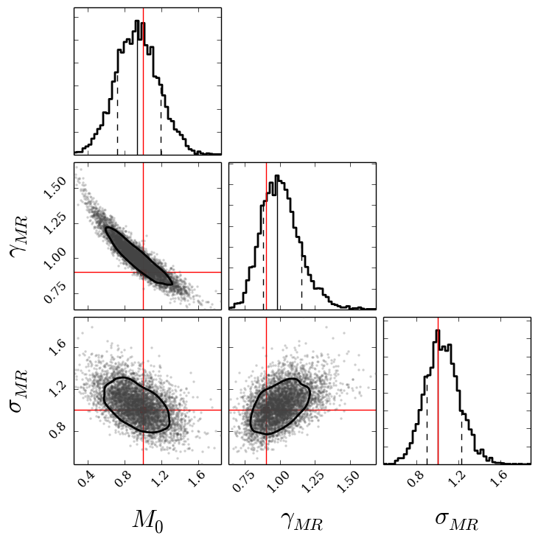
Case Study 2: Model performs well using simulated data with artificially small measurement uncertainties.
Frequency
Ndata = 120 pairs
Truths:
M_{o} = 1.0
γ_{MR} = 0.9
σ_{MR} = 1.0

Slide 28
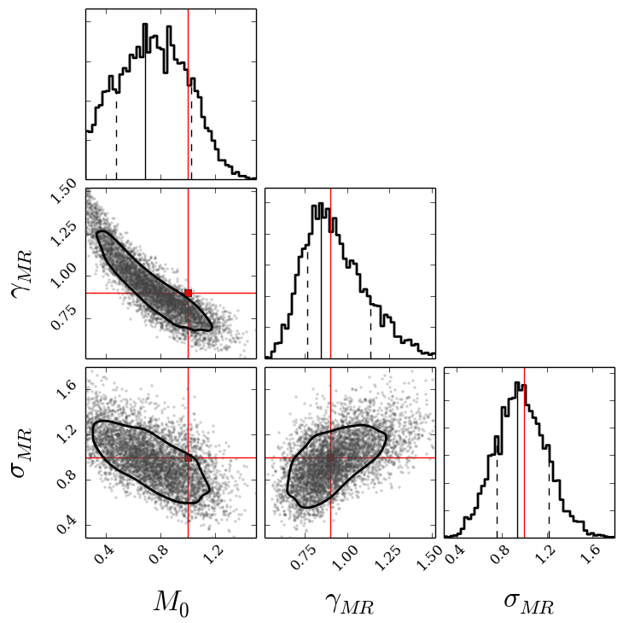
Case Study 2: Model performs well using simulated data with real Kepler Measurement Uncertainties.
Frequency
Ndata = 120 pairs
Truths:
M_{o} = 1.0
γ_{MR} = 0.9
σ_{MR} = 1.0

Slide 29
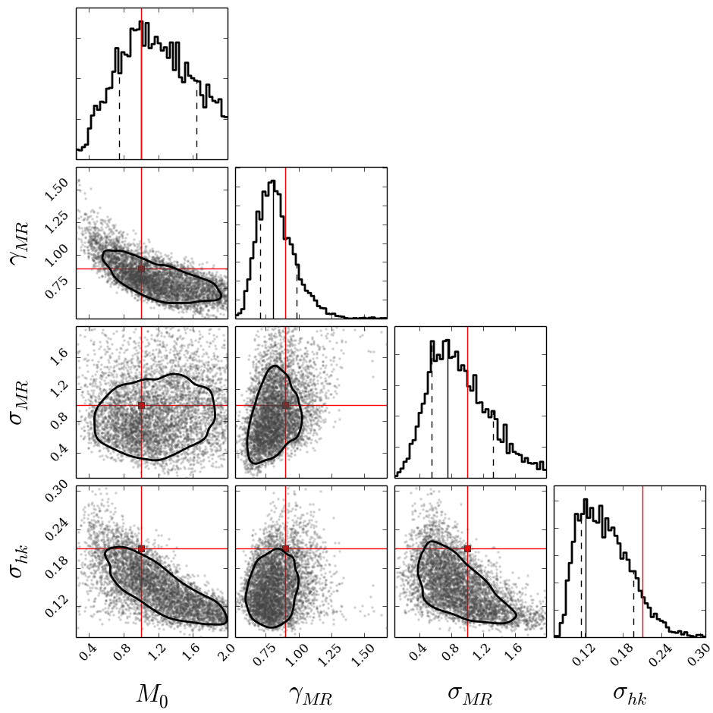
Case Study 2: Model performs well using simulated data with one-component eccentricity distribution.
Frequency
Ndata = 120 pairs
Truths:
M_{o} = 1.0
γ_{MR} = 0.9
σ_{MR} = 1.0
σ_{hk} = 0.2

Slide 30
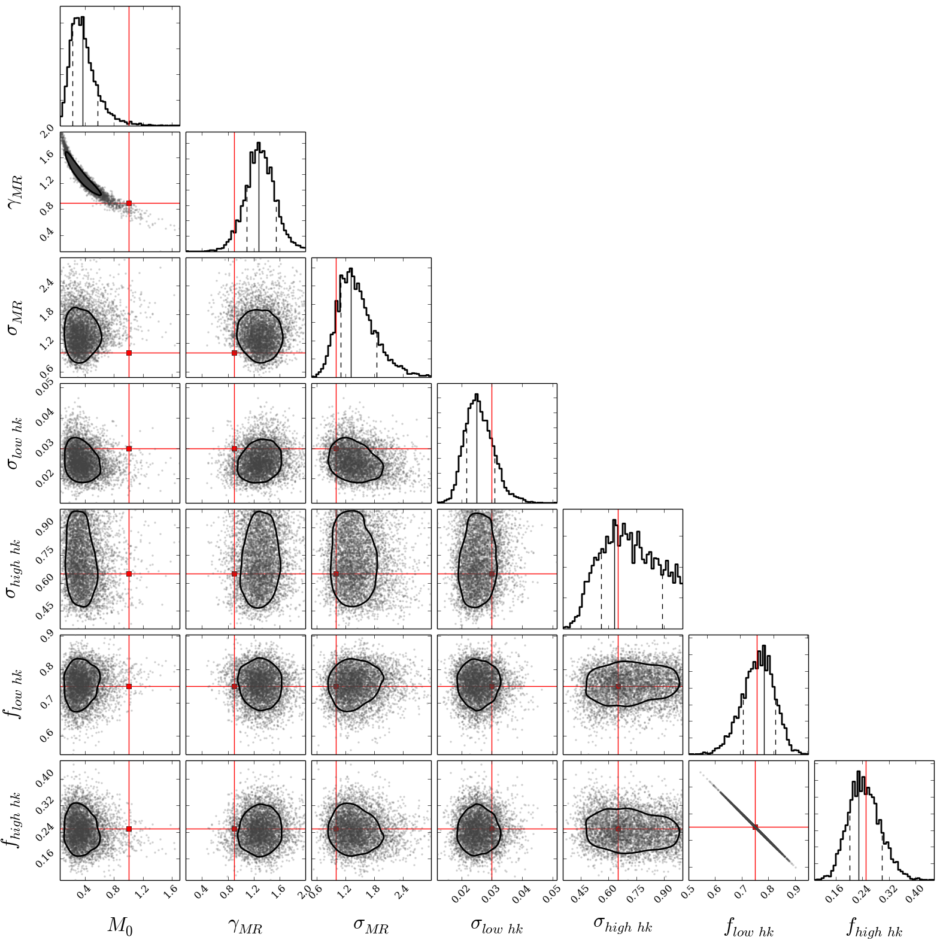
Case Study 2: Model performs well using simulated data with with Eccentricity Distribution of Increased Complexity
Frequency
Ndata = 120 pairs
Truths:
M_{o} = 1.0
γ_{MR} = 0.9
σ_{MR} = 1.0
F_{hk low} = 0.75
f_{hk} _{high} = 0.25
σ_{hk} _{low} = 0.03
σ_{hk} _{high} = 0.65
Two-Component Gaussian Mixture Model for Eccentricity

Slide 31
Case Study 2: The Mass-Radius-Eccentricity Distribution of Near-Resonant Transiting Exoplanet Pairs: Potential Biases
Inferred mass-radius is suspiciously flat/low mass compared to theoretical models.
TTV planet pairs near first order MMR may have different formation history than other classes of planets and thus differ in their composition and structure.
Need to further test model assumptions
Gaussianity
Stellar properties
M-R power law potentially not flexible
Mass scatter could depend on mass/radius
Currently treating eccentricity distribution as separable from mass-radius distribution

Slide 32
Case study 3: The Period-Eccentricity Distribution of Eclipsing Binaries from Kepler
Probe binary star formation
Probe efficiency of tidal circularization

Slide 33
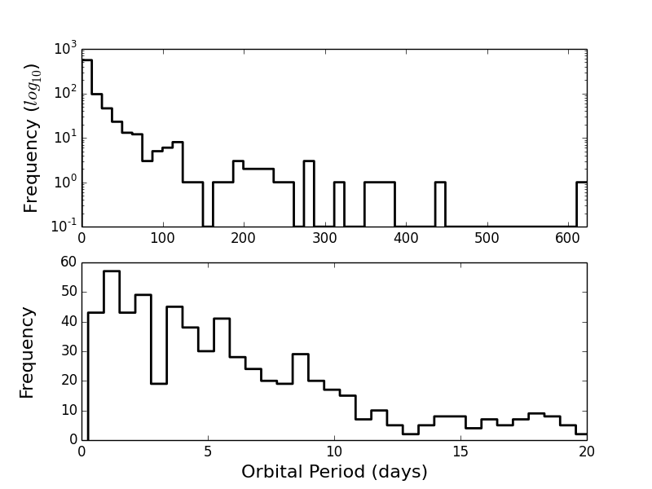
Input: The Period-Eccentricity Distribution of Eclipsing Binaries from Kepler
Ndata = 795 EBs

Slide 34
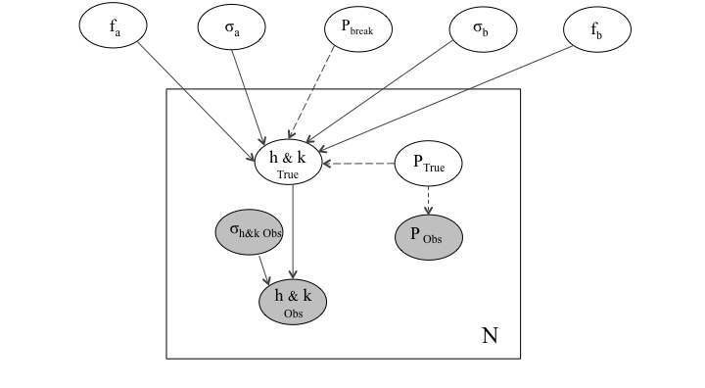
Case study 3: The Period-Eccentricity Distribution of Eclipsing Binaries from Kepler Graphical Model of Bayesian Network:
P_{break} => period transition where the eccentricity distribution differs above and below

Slide 35
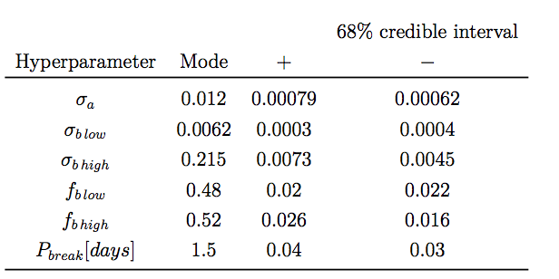
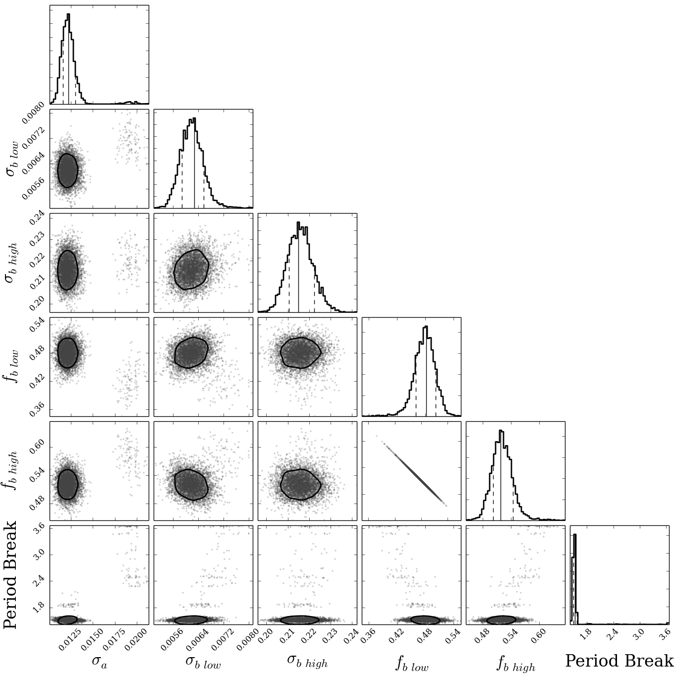
Case study 3: The Period-Eccentricity Distribution of Eclipsing Binaries from Kepler
Shabram, Prsa in prep

Slide 36
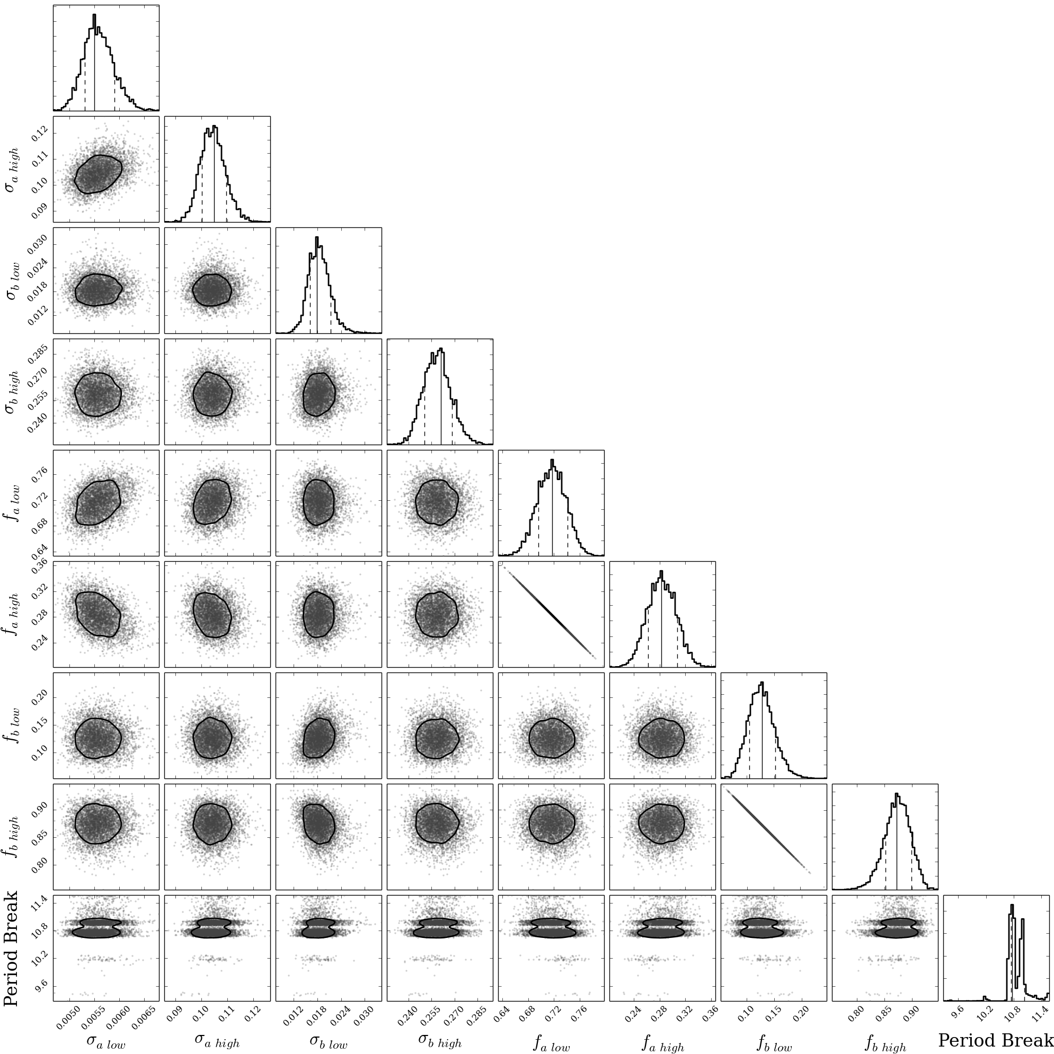
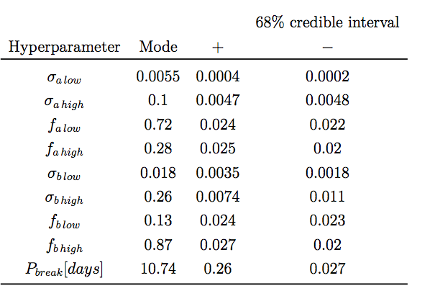
Case study 3: The Period-Eccentricity Distribution of Eclipsing Binaries from Kepler
~70% below 11 days are very circularized
~90% above 11 days exhibit a wide range of eccentricities
Shabram, Prsa in prep

Slide 37
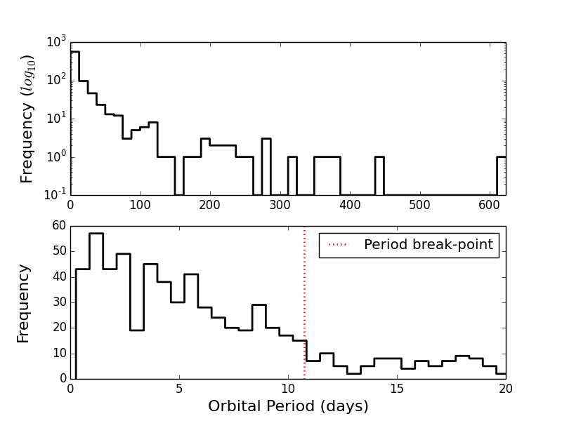
Case study 3: The Period-Eccentricity Distribution of Eclipsing Binaries from Kepler
Lathem et al. (2002) and Mayor et. al. (2001) find period transition at ~10days

Slide 38
Case Study 3: The Period-Eccentricity Distribution of Eclipsing Binaries from Kepler: Potential Biases
Sample focuses on short-period EBs
Sample dominated by field stars from the disk (as apposed to cluster or halo stars)
Model doesn’t include difference in stellar properties
Model assumes simple dependence on period

Slide 39
Thank You!

Slide 40
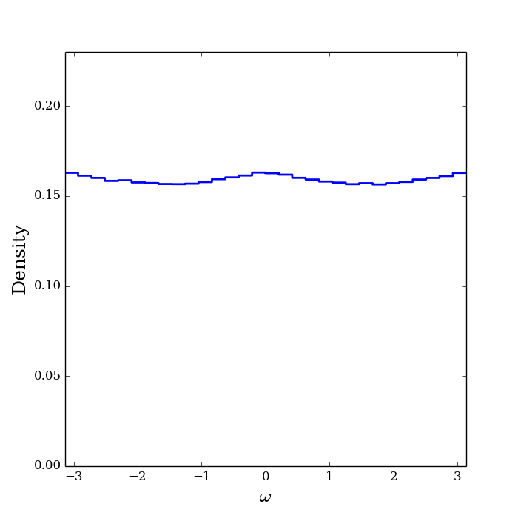
Detection bias

